Slide 1
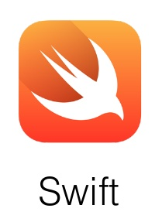
CS 360 Programming Languages First-class functions

Slide 2

Functions

Slide 3
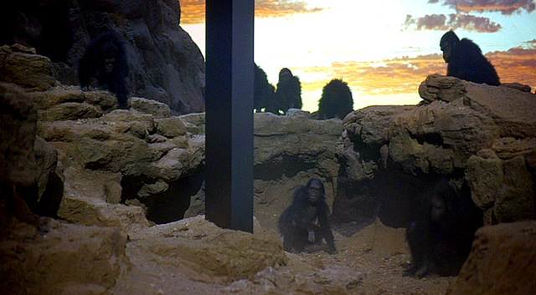
Today's lecture will take your programming skills from this…

Slide 4

…to this!

Slide 5
An Example
What if we wanted to add up all the numbers from a to b?
(define (sum a b)
(if (> a b)
0
(+ a
(sum (+ a 1) b))))

Slide 6
An Example
What if we wanted to add up all the squares numbers from a to b?
(define (sum a b)
(if (> a b)
0
(+ (expt a 2)
(sum (+ a 1) b))))

Slide 7
An Example
What if we wanted to add up all the absolute values of the numbers from a to b?
(define (sum a b)
(if (> a b)
0
(+ (abs a)
(sum (+ a 1) b))))

Slide 8
These functions are all very similar
All three of these functions differ only in how the sequence of integers from a to b are transformed before they are all added together.
The adding process itself is identical in all of the functions:
(define (sum-something a b)
(if (> a b)
0
(+ (do something to a)
(sum-something (+ a 1) b))))
What if there were a general sum function that could sum up any sequence of this form?

Slide 9
A function that takes a function
Imagine a function that could take another function as an argument:
(define (sum-any func a b)
(if (> a b)
0
(+ (func a)
(sum-any func (+ a 1) b))))

Slide 10
Sum-any in action!
(sum-any sqrt 1 10)
=> sqrt(1) + sqrt(2) + sqrt(3) + …
=> about 22.5
(define (square x) (* x x))
(sum-any square 1 4)
=> 1^2 + 2^2 + 3^2 + 4^2 => 1 + 4 + 9 + 16 => 30
(define (identity x) x)
(sum-any identity 1 4)
=> 10

Slide 11
How to use sum-any
You can put the name of any function in place of sqrt, square, or identity, and sum-any will compute f(a) + f(a + 1) + f(a + 2) + … + f(b)
Provided f is a function of a single numeric argument.
What if you want to compute f(a^2/2) + f((a+1)^2/2) + …
Fine to do:
(define (silly-function x) (/ (* x x) 2))
(sum-any silly-function 1 10)
Wouldn't it be nicer if we didn't have to name that silly function?

Slide 12
Anonymous Functions
Functional programming languages allow us to create functions without names.
In Racket, we use the keyword lambda for this:
(lambda (arg1 arg2…) body)
This expression represents an anonymous function.
Kind of like a "function literals."

Slide 13
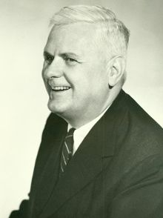
Aside: lambda calculus
Formal system for computation based on function abstraction and application.
Church-Turing thesis (1936-37) proved lambda calculus is equivalent in power to Turing machines.
Alonzo Church

Slide 14
Anonymous Functions
Use an anonymous function when you need a "temporary" function:
(sum-any (lambda (x) (/ (* x x) 2)) 1 10)
is better style than
(define (silly-function x) (/ (* x x) 2))
(sum-any silly-function 1 10)
Compare:
(sum-any (lambda (x) (* x x)) 1 10) and
(define (square (x) (* x x)) (sum-any square 1 10)

Slide 15
Using anonymous functions
Most common use: Argument to a higher-order function
Don’t need a name just to pass a function
But: Cannot use an anonymous function for a recursive function
Because there is no name for making recursive calls
(define (triple x) (* 3 x); named version
(lambda (x) (* 3 x)) ; anonymous version

Slide 16
Named functions vs anonymous functions
Named functions are mostly indistinguishable from anonymous functions.
In fact, naming a function with define uses the anonymous form behind the scenes:
(define (func arg1 arg2 …) expression)
is converted to:
(define func (lambda (arg1 arg2 …) expression))
It is poor style to define unnecessary functions in the global (top-level) environment
Use either nested defines, or anonymous functions.
Notes:
pi/4 = sum 1 to k of (-1)^(k+1)/(2k-1)

Slide 17
Higher-order functions
A higher-order function is a function that either takes a function (or more than one function) as an argument, or returns a function as a return value.
Possible because functions are first-class values (or first-class citizens), meaning we can use a function wherever we use a value.
First class citizens can be arguments to functions, returned from functions, bound to variables, and stored in data structures.
In Racket, a function can be stored anywhere any other data type would be stored.
Most common use is as an argument / result of another function

Slide 18



Slide 21
Higher-order functions
Let's see another:
(define (do-n-times func n x)
(if (= n 0) x
(do-n-times func (- n 1) (func x))))
This function computes f(f(f…(x))), where the number of applications of f is n.
Notes:
define increment, increment a number
then do it with lambda
try it with double
try it with cdr

Slide 22
Some uses for do-n-times
Get-nth:
(define (get-nth lst n) (car (do-n-times cdr n lst)))
Exponentiation:
(define (power x y) ; raise x to the y power (do-n-times (lambda (a) (* x a)) y 1))
Note how in the exponentiation example, the anonymous function uses variable x from the outer environment.
Couldn't do that without being able to nest functions.
Note how do-n-times can work with any data type (e.g., lists, numbers…)

Slide 23
On to first-class functions
“Functional programming” can mean a few different things:
Avoiding mutation in most/all cases (done and ongoing)
Using functions as values (the next week)

Slide 24
First-class functions
Functions are (first-class) values: Can use them wherever we use values
Arguments, results of functions, elements of lists, bound to variables, etc
Most common use is as an argument / result of another function
The other function is called a higher-order function
Powerful way to factor out common functionality
3-ish lectures on how and why to use first-class functions

Slide 25
Example
Can reuse n_times rather than defining many similar functions
Computes f(f(…f(x))) where number of calls is n
fun n_times (f,n,x) =
if n=0
then x
else f (n_times(f,n-1,x))
fun double x = x + x
fun increment x = x + 1
val x1 = n_times(double,4,7)
val x2 = n_times(increment,4,7)
val x3 = n_times(tl,2,[4,8,12,16,20])
fun double_n_times (n,x) = n_times(double,n,x)
fun nth_tail (n,x) = n_times(tl,n,x)

Slide 26
Types
val n_times : ('a -> 'a) * int * 'a -> 'a
Two of our examples instantiated 'a with int
One of our examples instantiated 'a with int list
This polymorphism makes n_times more useful
Type is inferred based on how arguments are used (later lecture)
Describes which types must be exactly something (e.g., int) and which can be anything but the same (e.g., 'a)

Slide 27
Polymorphism and higher-order functions
Many higher-order functions are polymorphic because they are so reusable that some types, “can be anything”
But some polymorphic functions are not higher-order
Example: length : 'a list -> int
And some higher-order functions are not polymorphic
Example: times_til_0 : (int -> int) * int -> int
fun times_til_0 (f,x) =
if x=0 then 0 else 1 + times_til_0(f, f x)
* Would be better with tail-recursion

Slide 28
Toward anonymous functions
Definitions unnecessarily at top-level are still poor style:
fun triple x = 3*x
fun triple_n_times (f,x) = n_times(triple,n,x)
So this is better (but not the best):
fun triple_n_times (f,x) =
let fun trip y = 3*y
in
n_times(trip,n,x)
end
And this is even smaller scope
It makes sense but looks weird (poor style; see next slide)
fun triple_n_times (f,x) =
n_times(let fun trip y = 3*y in trip end, n, x)

Slide 29
Anonymous functions
This does not work: A function binding is not an expression
fun triple_n_times (f,x) =
n_times((fun trip y = 3*y), n, x)
This is the best way we were building up to: an expression form for anonymous functions
fun triple_n_times (f,x) =
n_times((fn y => 3*y), n, x)
Like all expression forms, can appear anywhere
Syntax:
fn not fun
=> not =
no function name, just an argument pattern

Slide 30
A style point
Compare:
With:
So don’t do this:
When you can do this:
(if x #t #f)
(lambda (x) (f x)
(do-n-times (lambda (x) (cdr x)) 3 '(2 4 6 8))
(do-n-times cdr 3 '(2 4 6 8))

Slide 31
What does this function do?
(define (mystery lst)
(if (null? lst) '()
(cons (car lst) (mystery (cdr lst)))))

Slide 32
Map
(define (map func lst)
(if (null? lst) '()
(cons (func (car lst)) (map func (cdr lst)))))
Map is, without doubt, in the higher-order function hall-of-fame
The name is standard (same in most languages)
You use it all the time once you know it: saves a little space, but more importantly, communicates what you are doing
Built into Racket, so you don't have to include this definition in programs that use map.

Slide 33
Filter
(define (filter func lst)
(cond ((null? lst) '())
((func (car lst))
(cons (car lst) (filter func (cdr lst))))
(#t
(filter func (cdr lst)))))
Filter is also in the hall-of-fame
So use it whenever your computation is a filter

Slide 34
Returning functions
Remember: Functions are first-class values
For example, can return them from functions
Silly example:
Has type (int -> bool) -> (int -> int)
But the REPL prints (int -> bool) -> int -> int
because it never prints unnecessary parentheses and
t1 -> t2 -> t3 -> t4 means t1->(t2->(t3->t4))
fun double_or_triple f =
if f 7
then fn x => 2*x
else fn x => 3*x

Slide 35
Other data structures
Higher-order functions are not just for numbers and lists
They work great for common recursive traversals over your own data structures (datatype bindings) too
Example of a higher-order predicate:
Are all constants in an arithmetic expression even numbers?
Use a more general function of type
(int -> bool) * exp -> bool
And call it with (fn x => x mod 2 = 0)

